Slide 1
Non-Fungible Tokens
BLI Tutorial

Slide 2
Non-Fungible Tokens
Each token is unique and not substitutable for any other Token
Used for:
Digital Art
Ownership Rights
Identity
Rights in general

Slide 3
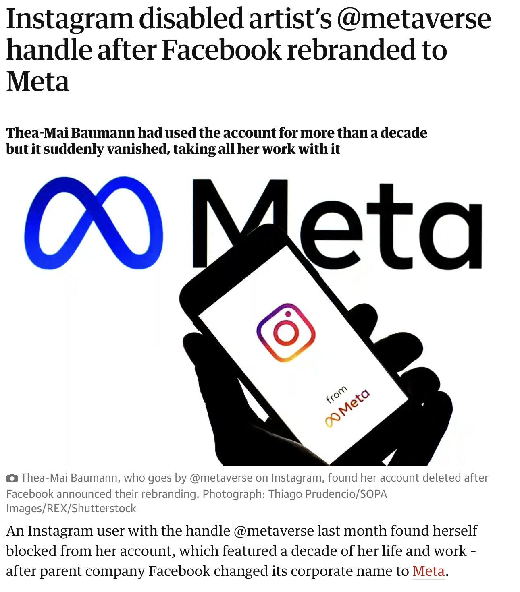
The Promise of NFTs… Data You Own

Slide 4
Problems with NFTs
No necessarily 1:1 relationship between NFT and real-world things
Ownership/persistence of the NFT can be trusted, but the not the link between the NFT and the thing it represents.
Owning an NFT that represents a share doesn’t mean you own the share
A supply chain NFT that says no slave labour has been used doesn’t mean no slave labour has been used

Slide 5
Oracles and Auditors
Maintaining trust tends to involve a trusted third party – an auditor/oracle – who is the trusted source of truth for the chain
A stock and station agent might confirm cows are real and alive
A consultant might audit environmental claims
An auditor might confirm proper wages have been paid
An apple watch might confirm health data…
We still don’t know the liability of oracles

Slide 6
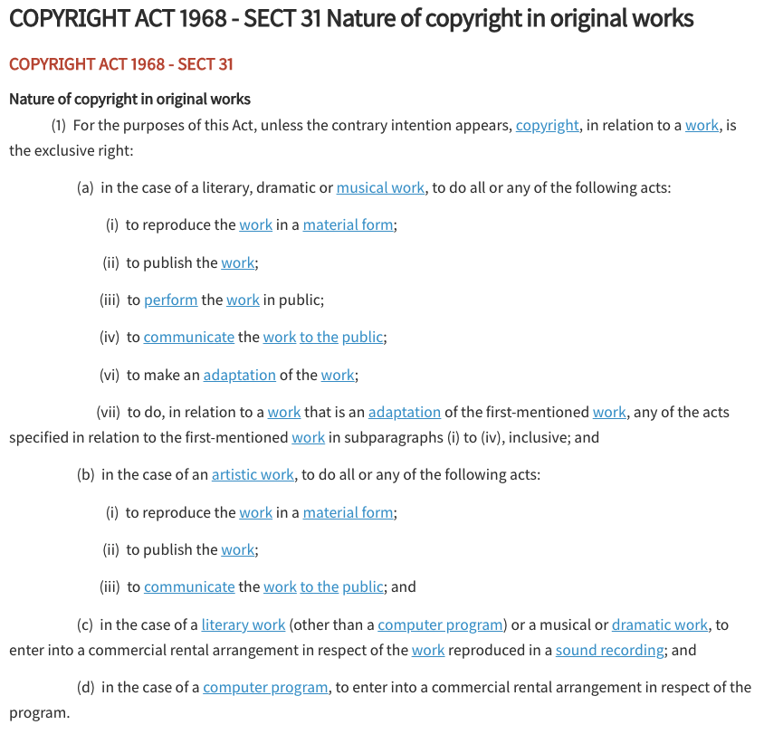
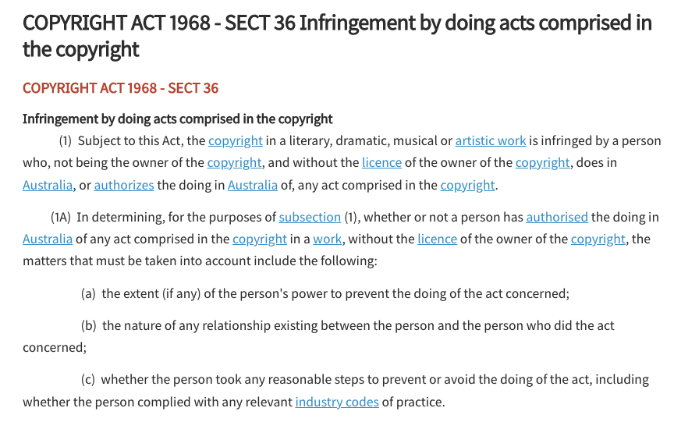
NFTs and Copyrights

Slide 7
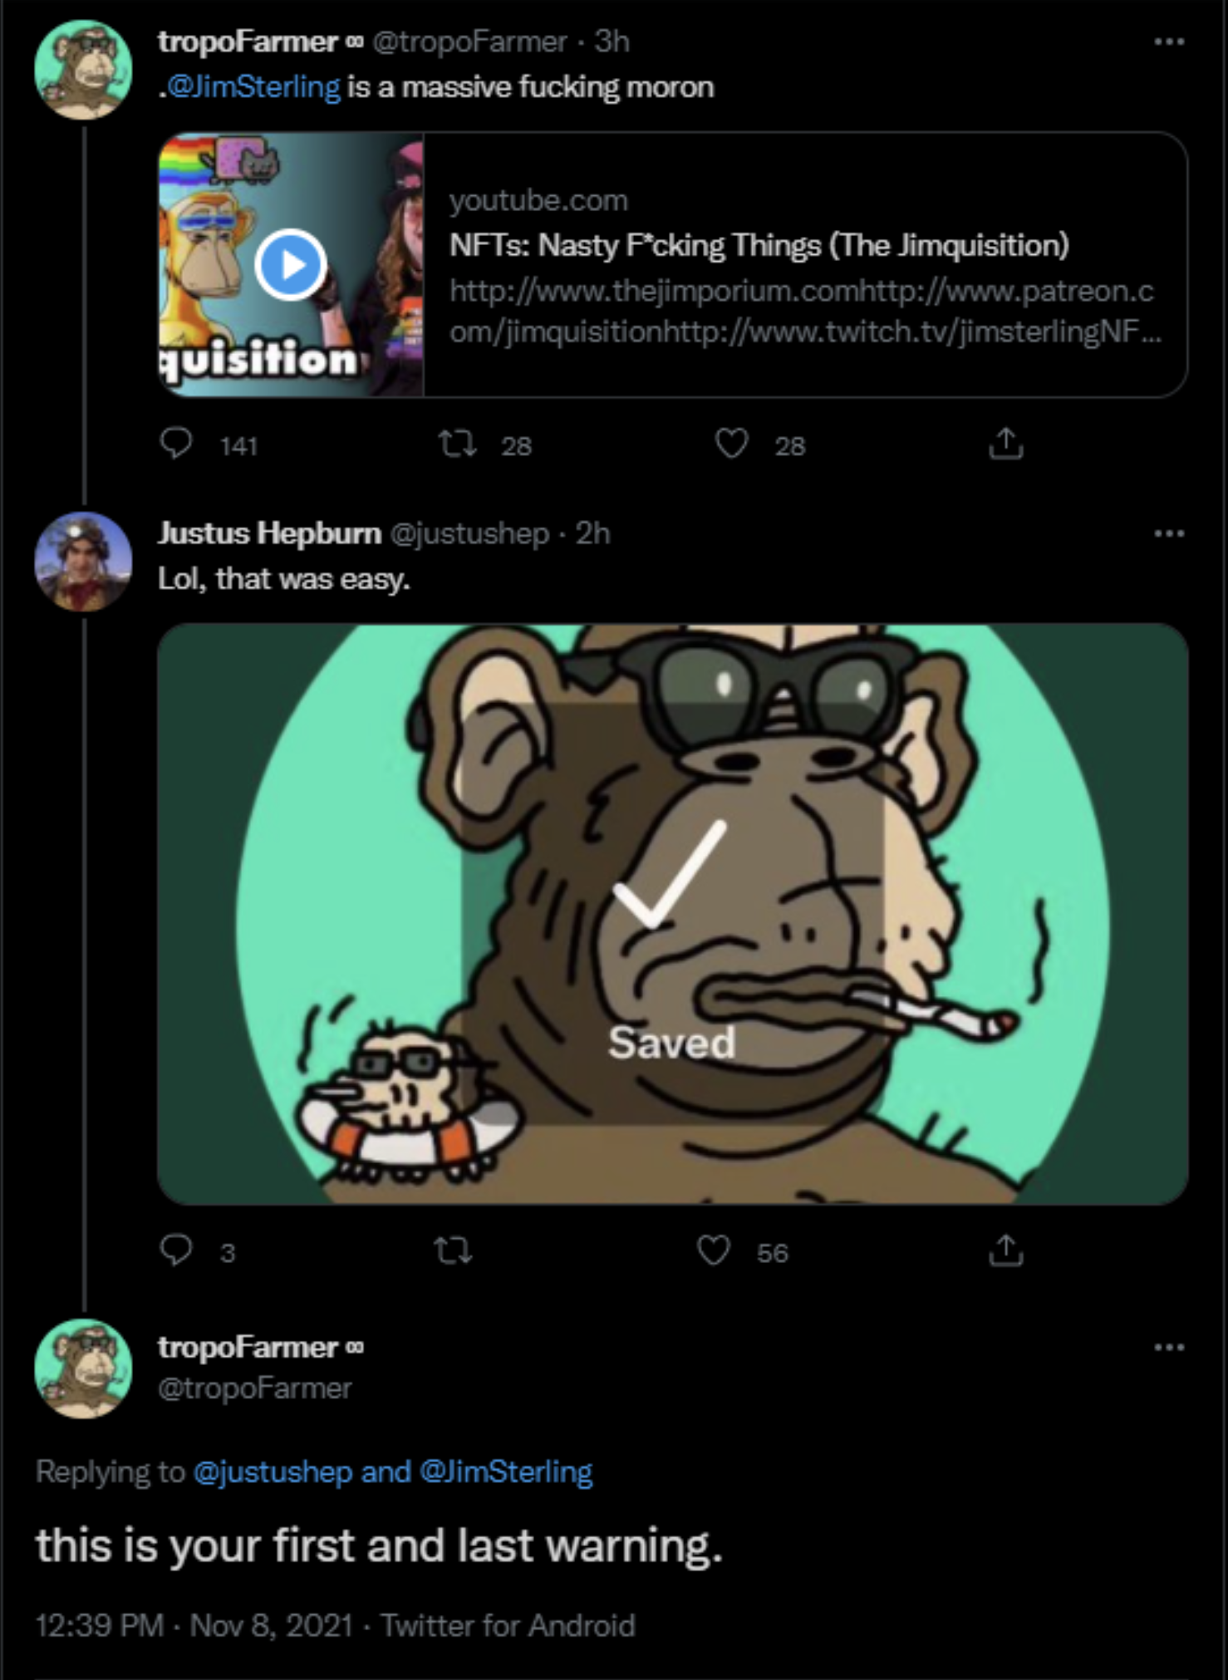
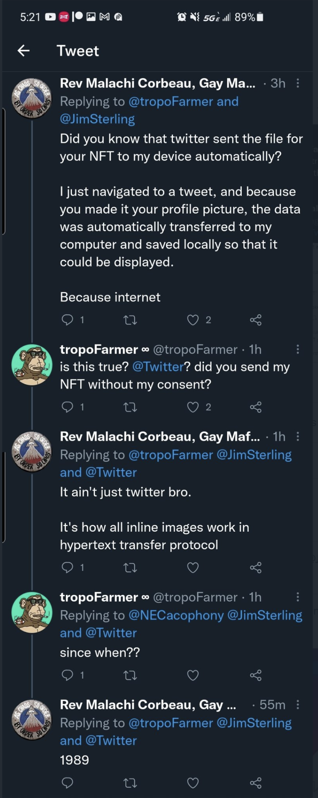
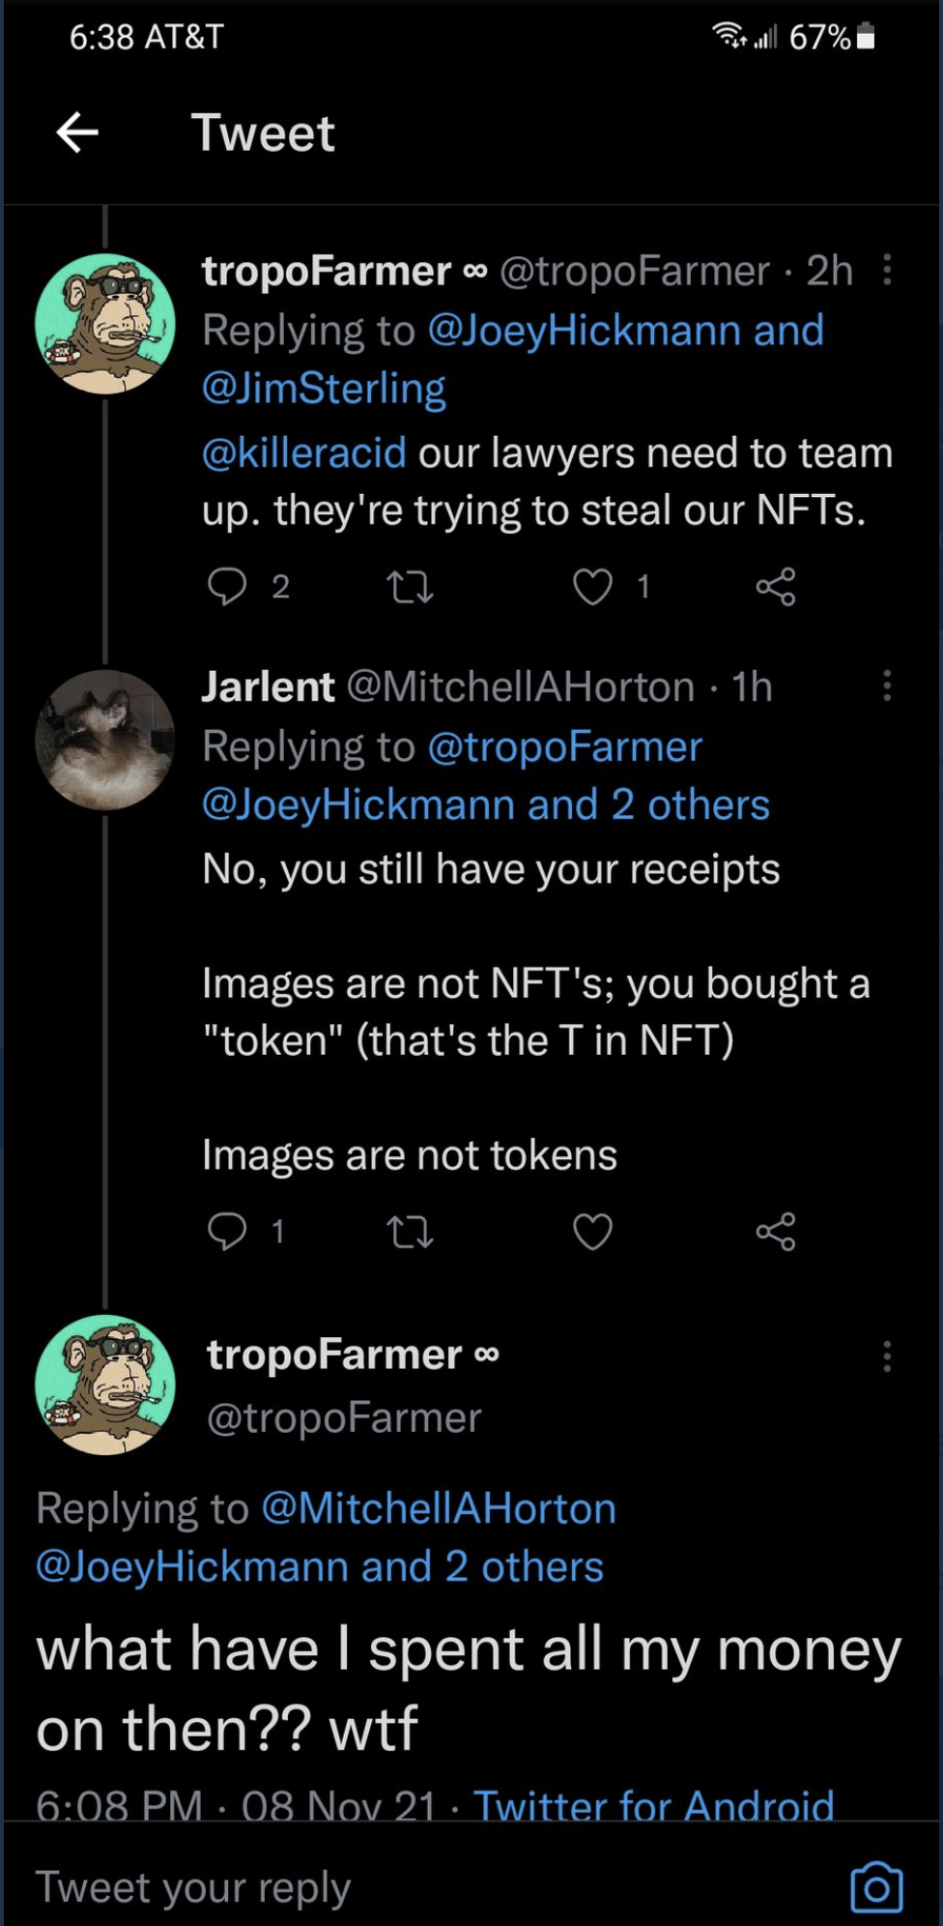
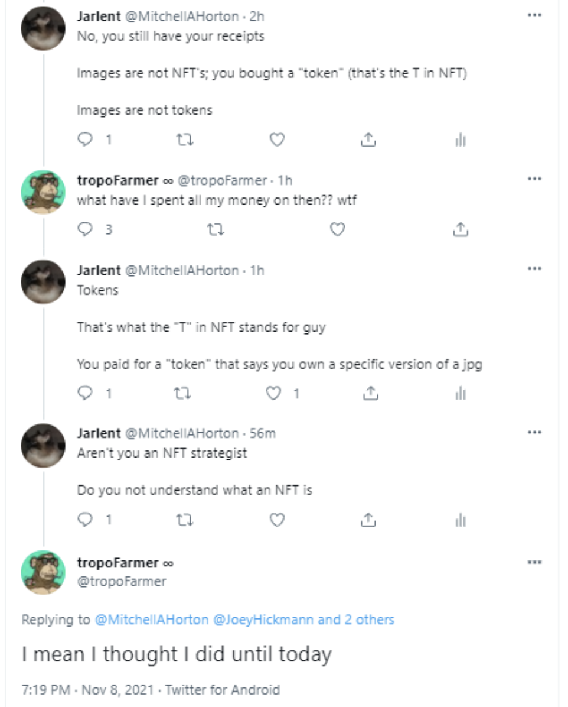
NFTs & Copyrights

Slide 8
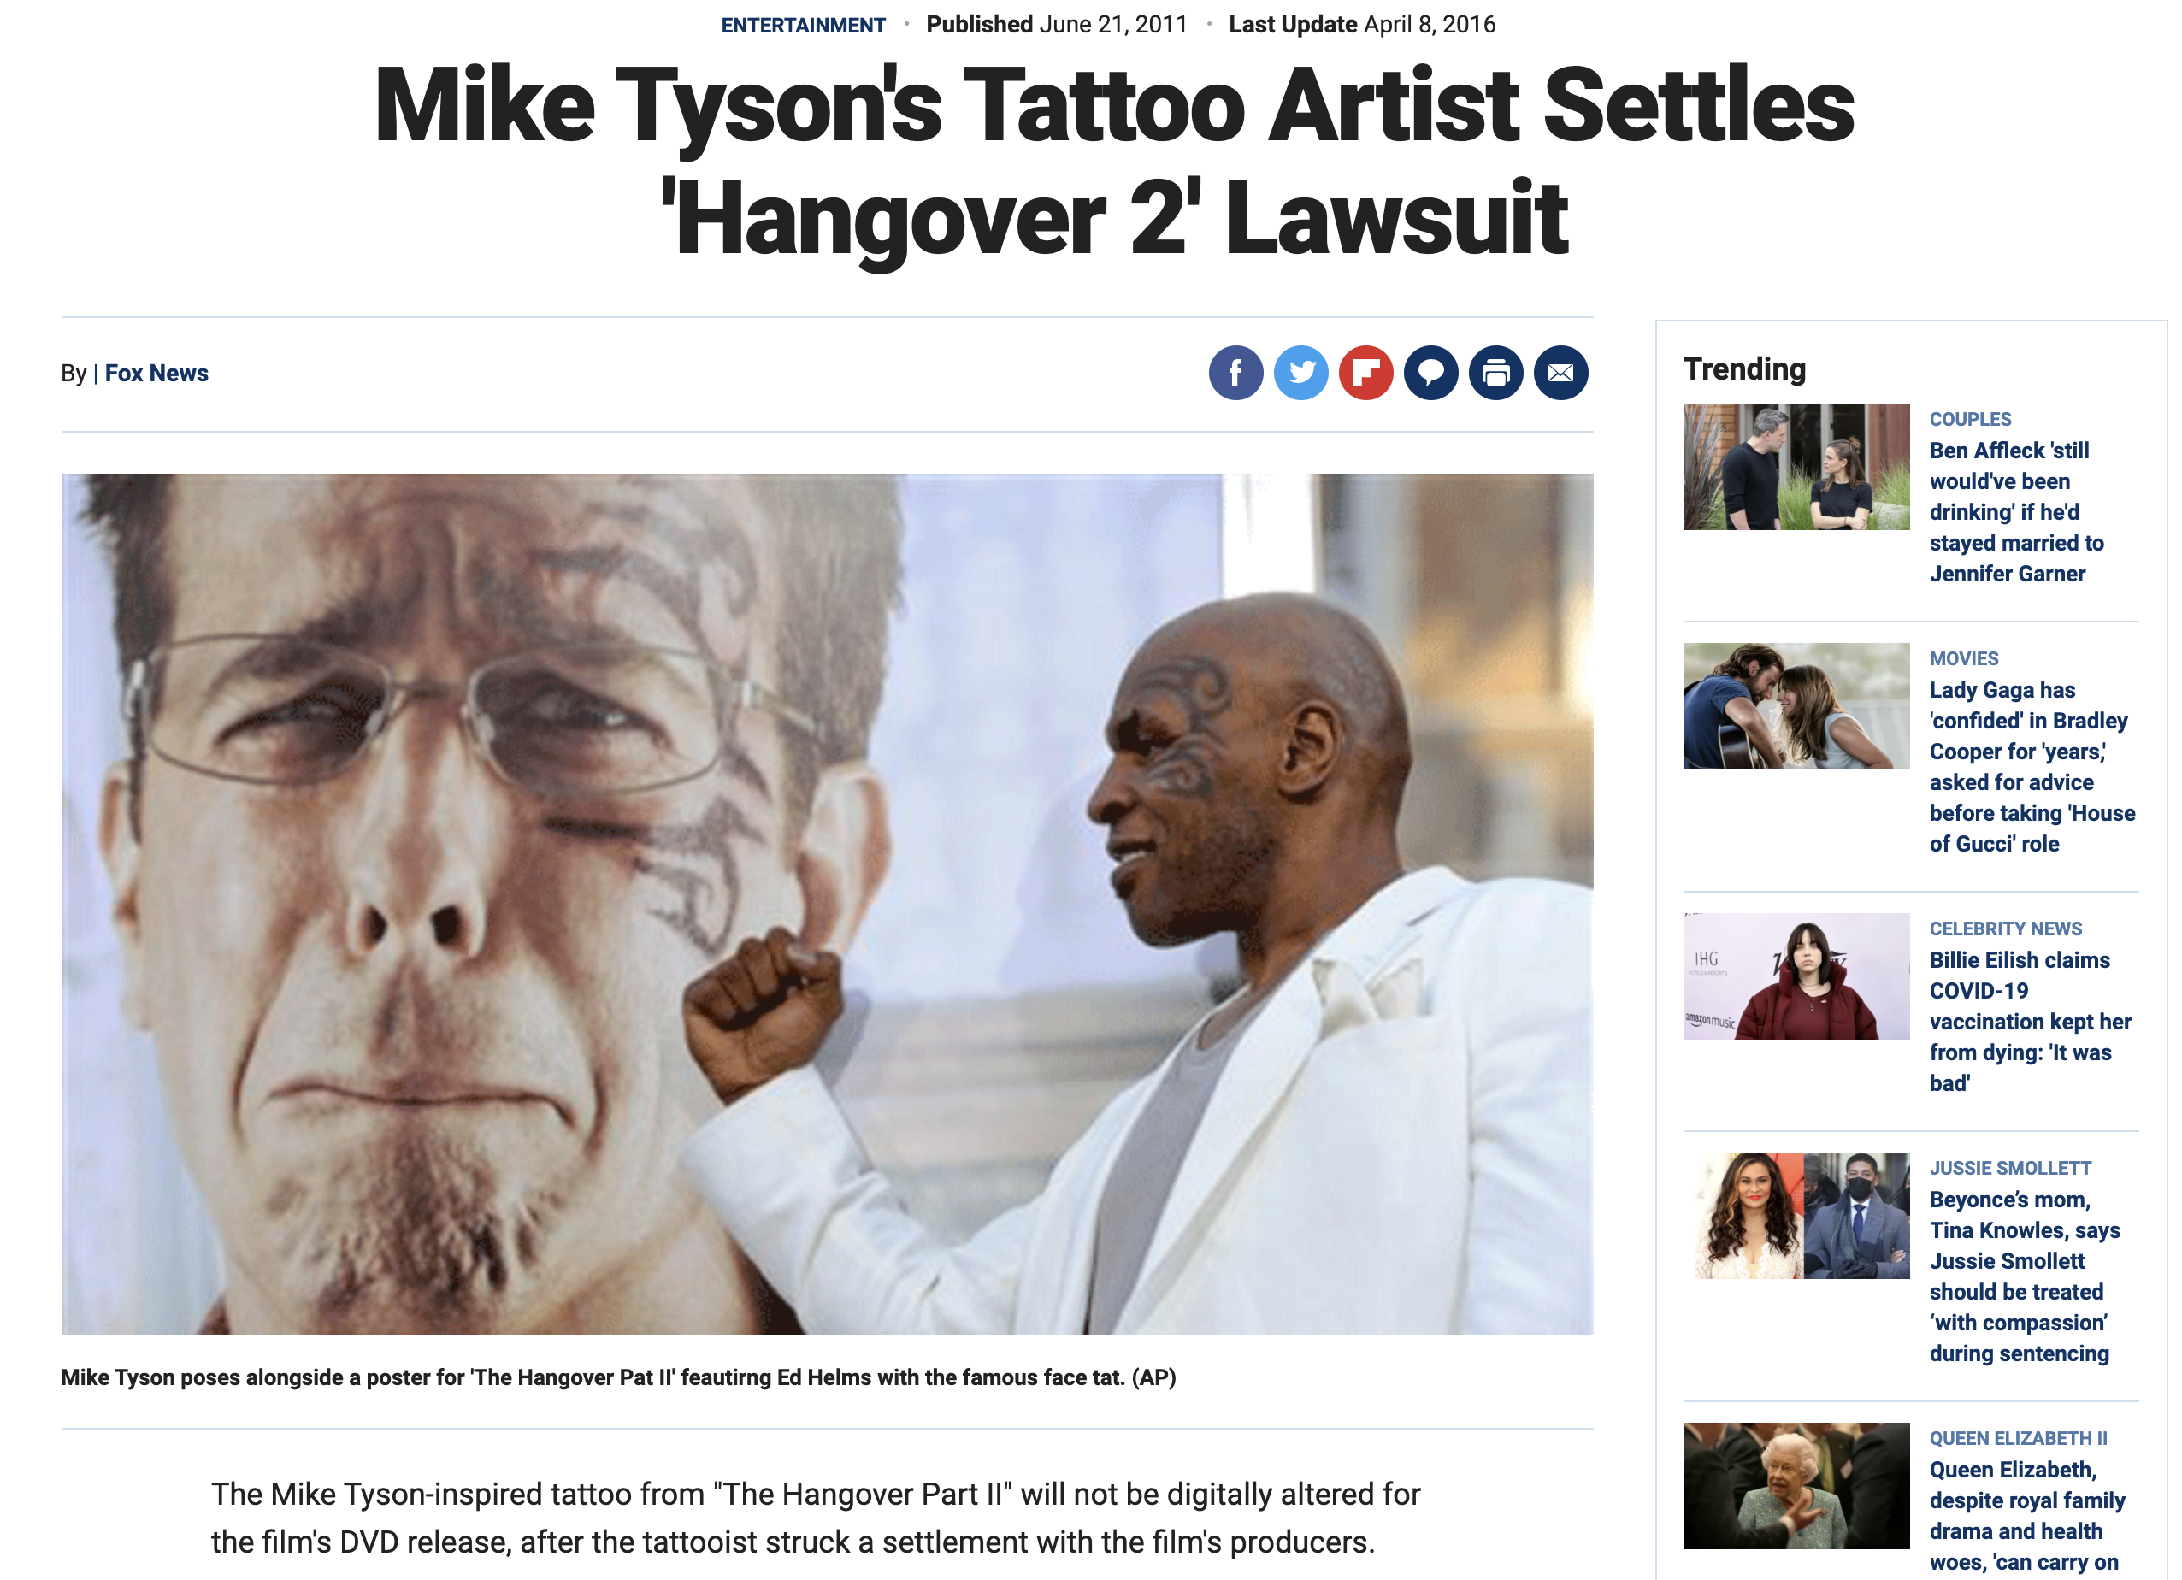
The Problem is Not New

Slide 9
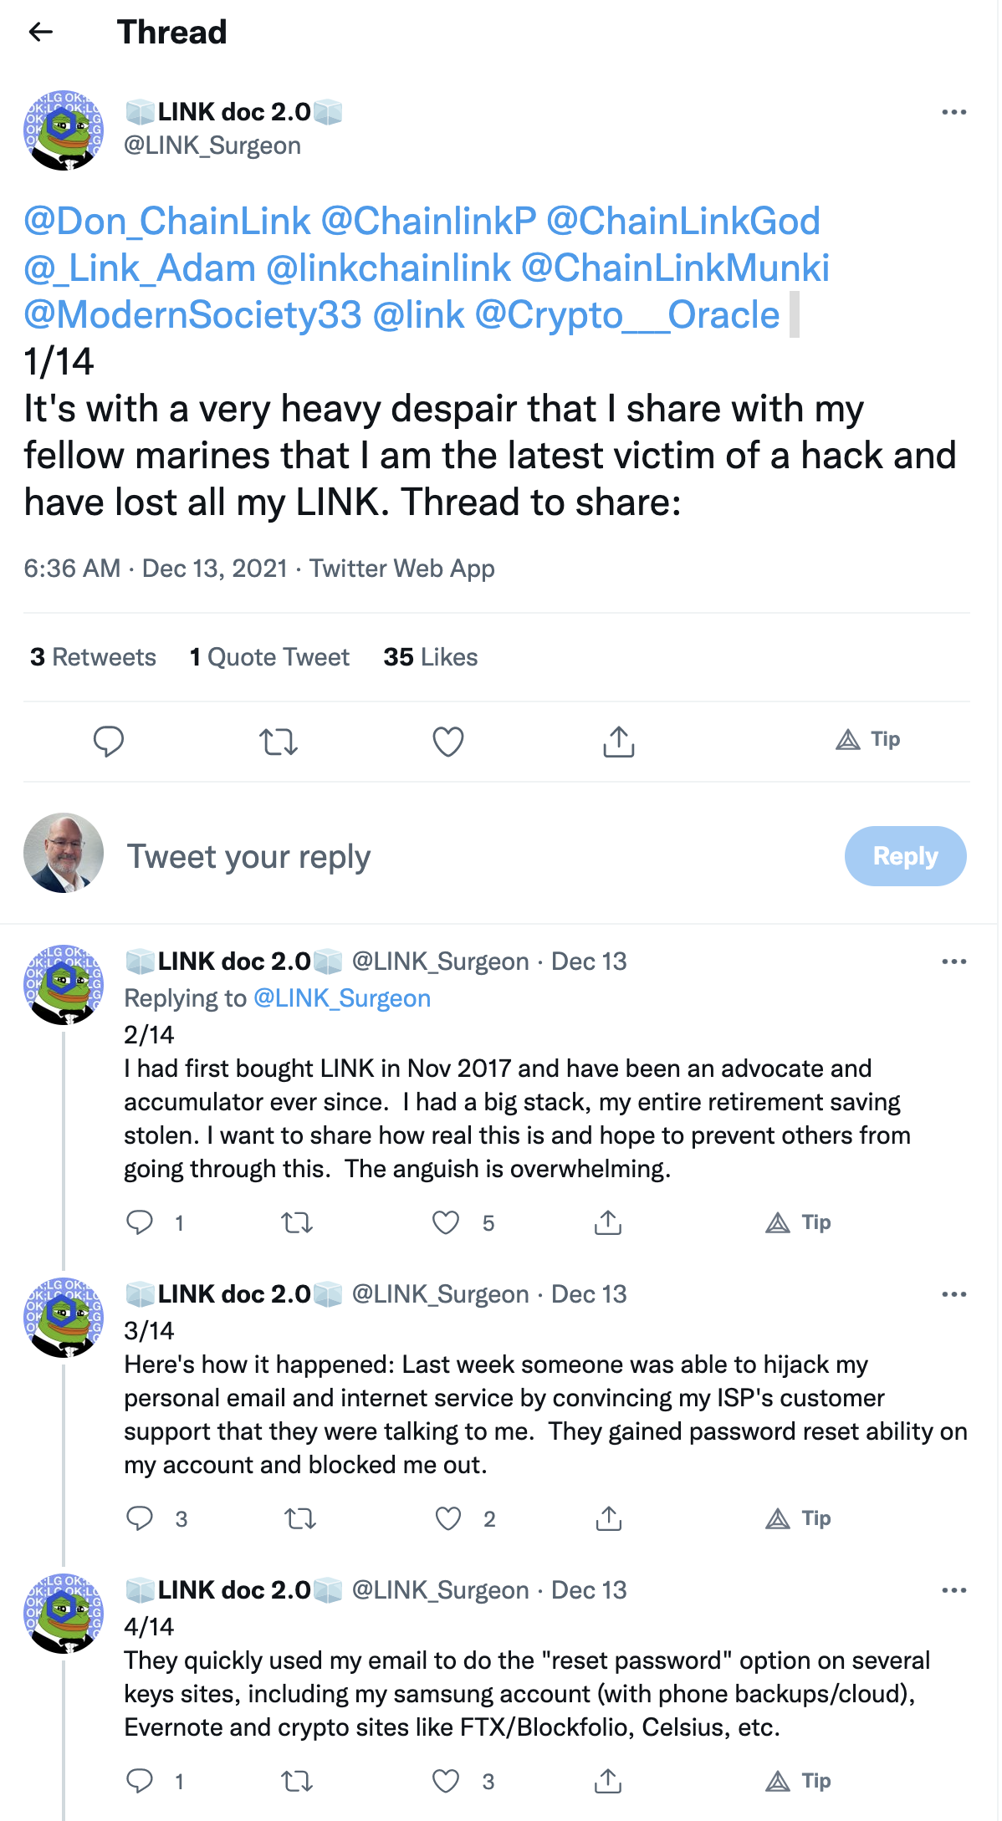
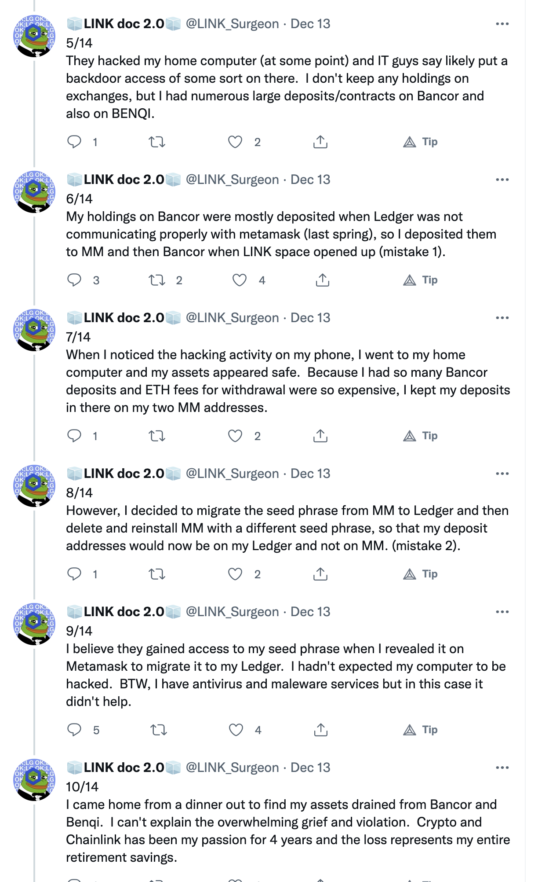
But What You Own Can Be Stolen… for Good

